Slide 1



Intelligent Warehouse Simulator ——
Full-Stack Collaborative Development Guide
Reporter：Group 1
date：2025/12/5

Slide 2


01.
Project Overview and Objectives
02.
the Grid and Physics Simulation Module
CONTENTS
03.
Path Planning and AI Decision-Making
04.
Network Protocols and Servers
05.
Client GUI and Visualization
06.
Task Scheduling and Collaboration

Slide 3



Project Overview
and Objectives
01

Slide 4
Vision of Intelligent Warehousing Simulator
In a 2D grid warehouse, multiple robots handle real-time picking and delivery with zero collisions, low latency, and full observability.。
Physical smoothing
Path unobstructed
Real-time online
The robot moves naturally and smoothly, without any jumping or stuttering.
Intelligent path planning ensures that multiple robots can collaborate without conflicts.
State synchronization is low-latency, and client observation is lag-free.

Slide 5
Overview of Six Major Subtasks and Roles
Grid Physics: Zhu Quanyuan
Path AI: Huang Ruitao
Network Protocol: Qiao Kun
Task Time : 22 days
Task Time : 16 days
Task Time : 18 days
GUI Client: Lin Jirun
Task Scheduling: Lin Jiahui
Integration: Bei Jiayi
Task Time : 21 days
Task Time : 23 days
Task Time : 26 days
The parallel development schedule is tight, and each module needs to be delivered on time to ensure smooth final integration.

Slide 6
the Grid and Physics Simulation Module
02

Slide 7
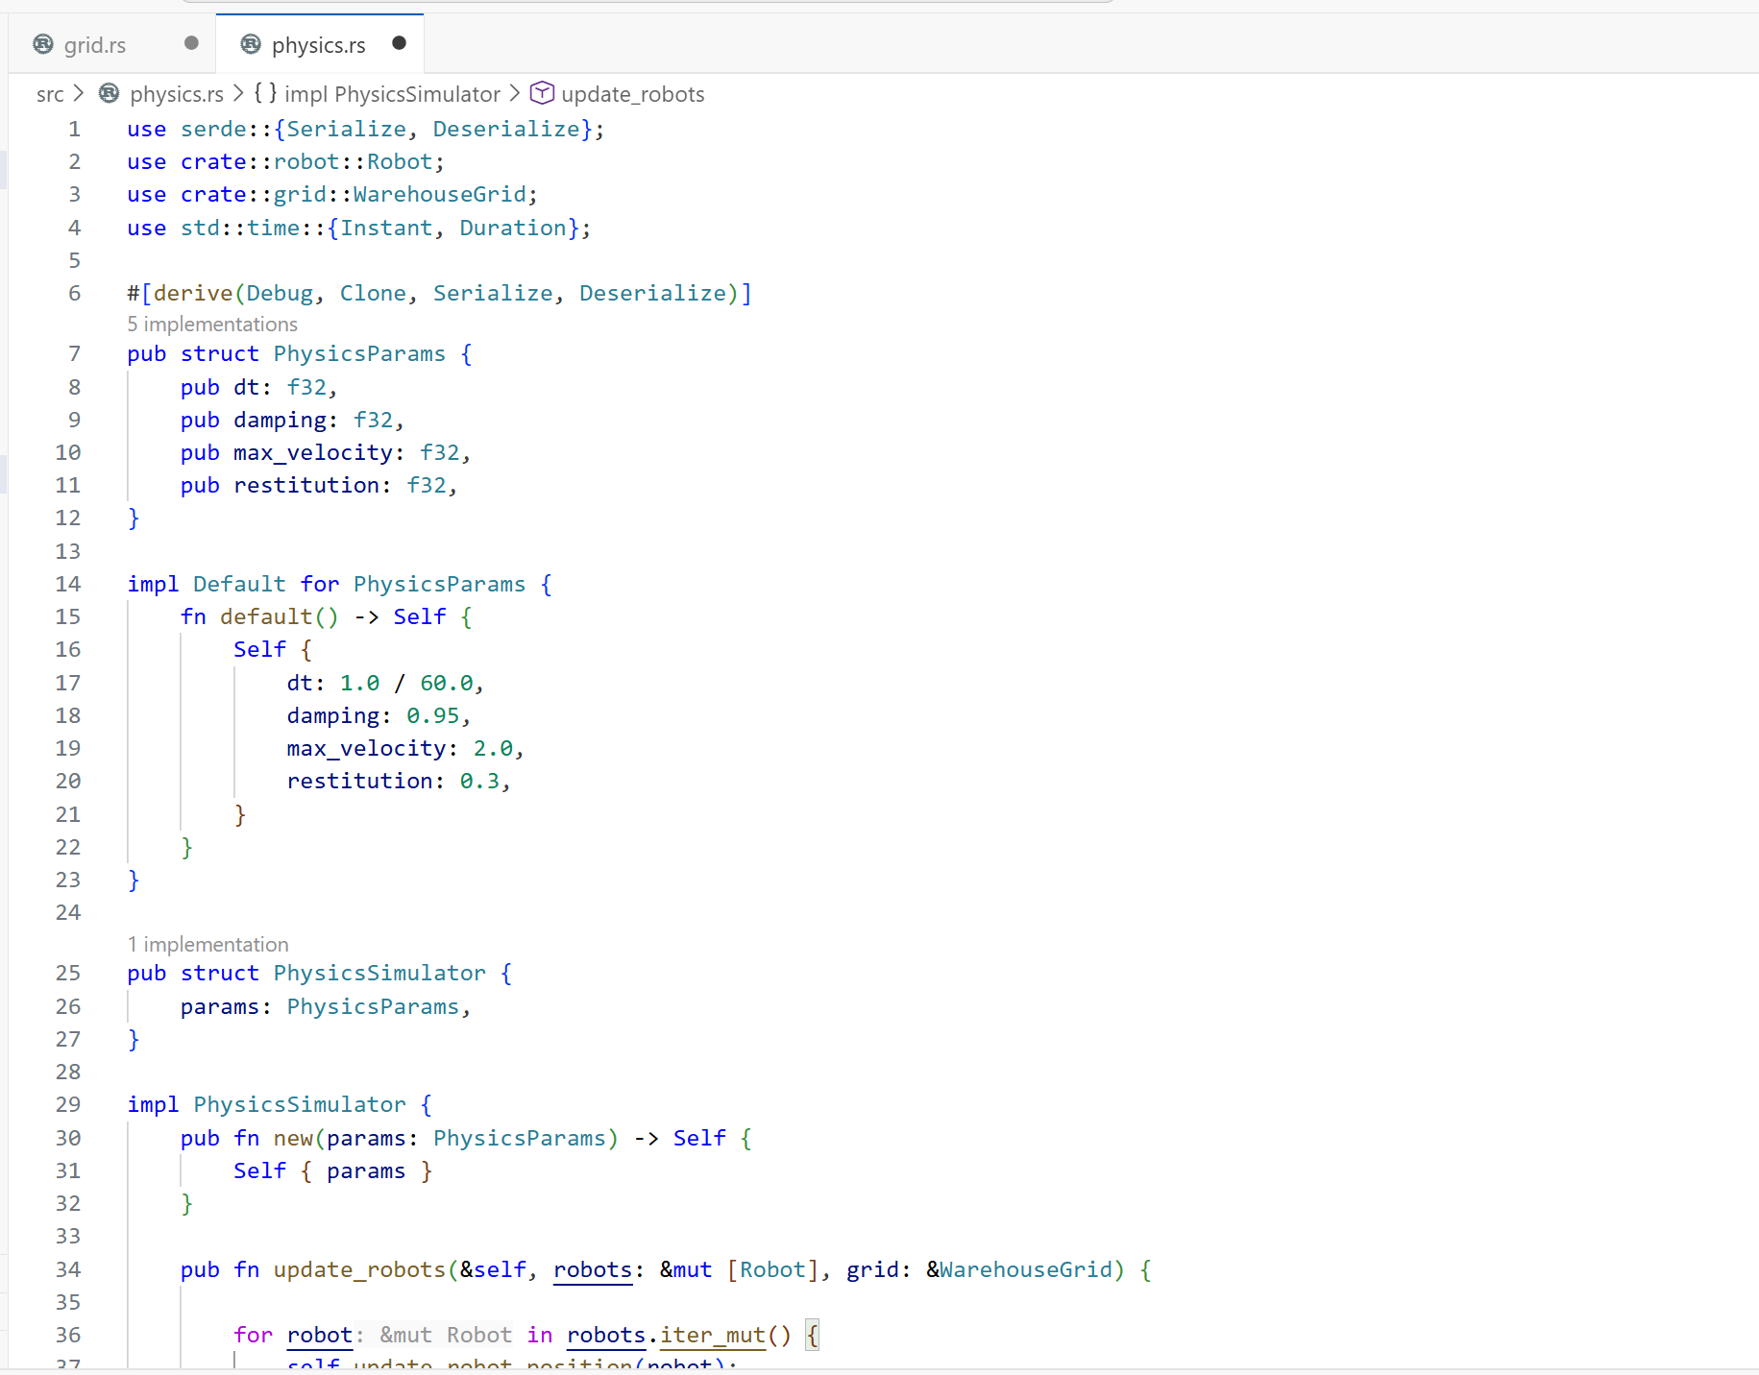
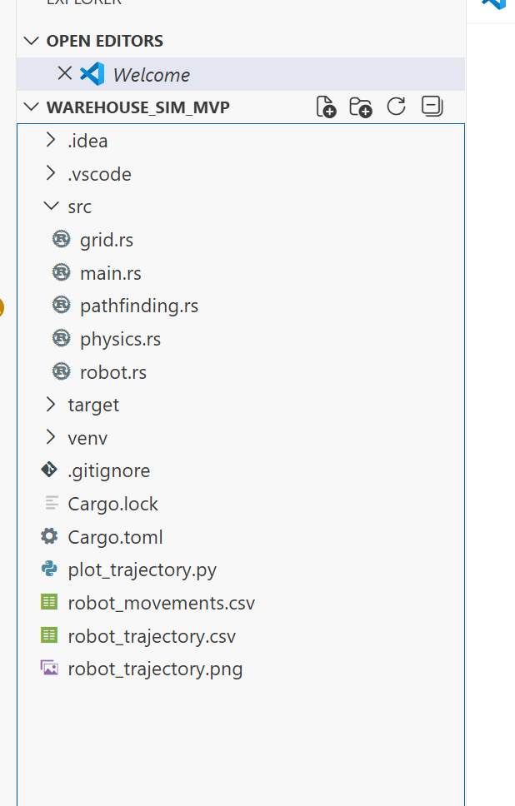
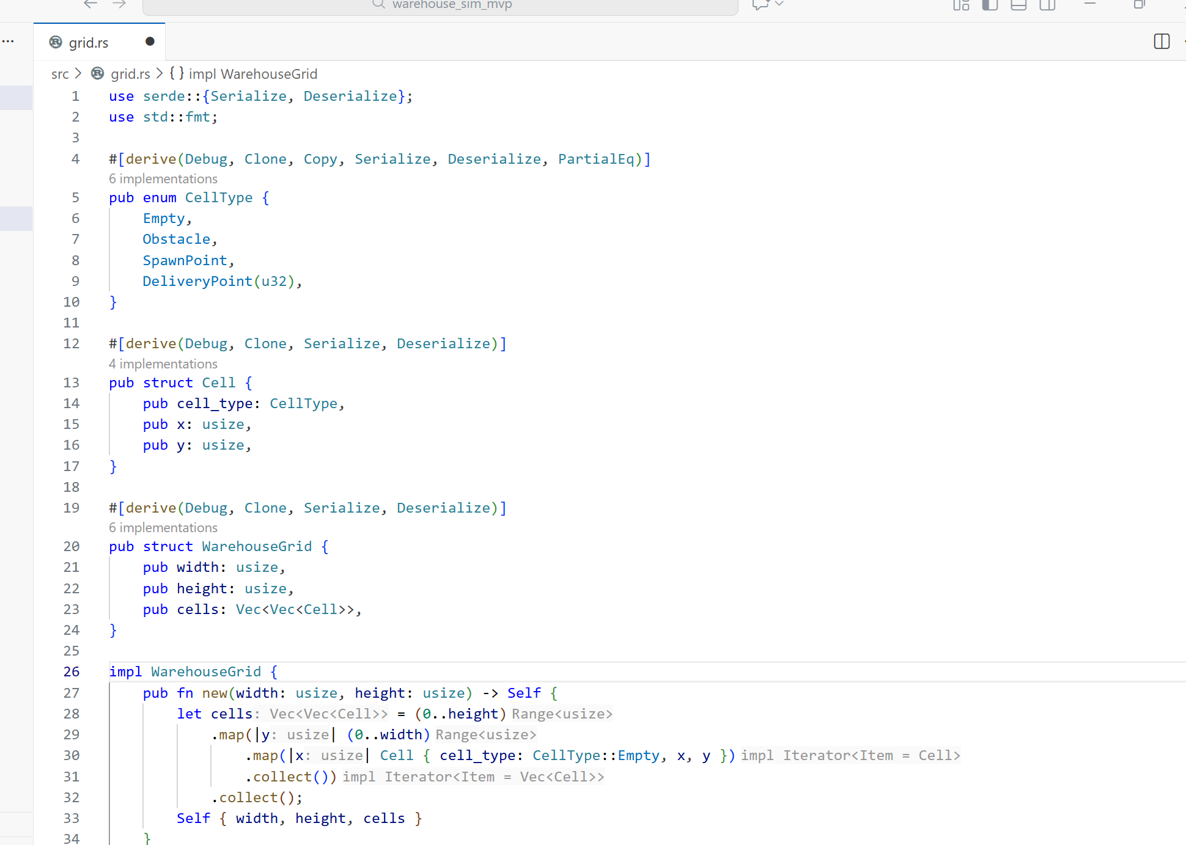
Project Overview
Subtask 1 Role: Core simulation foundation
Goal: Autonomous robots navigate, pick up/deliver packages
Grid model
Key Outputs
Physics engine

Slide 8
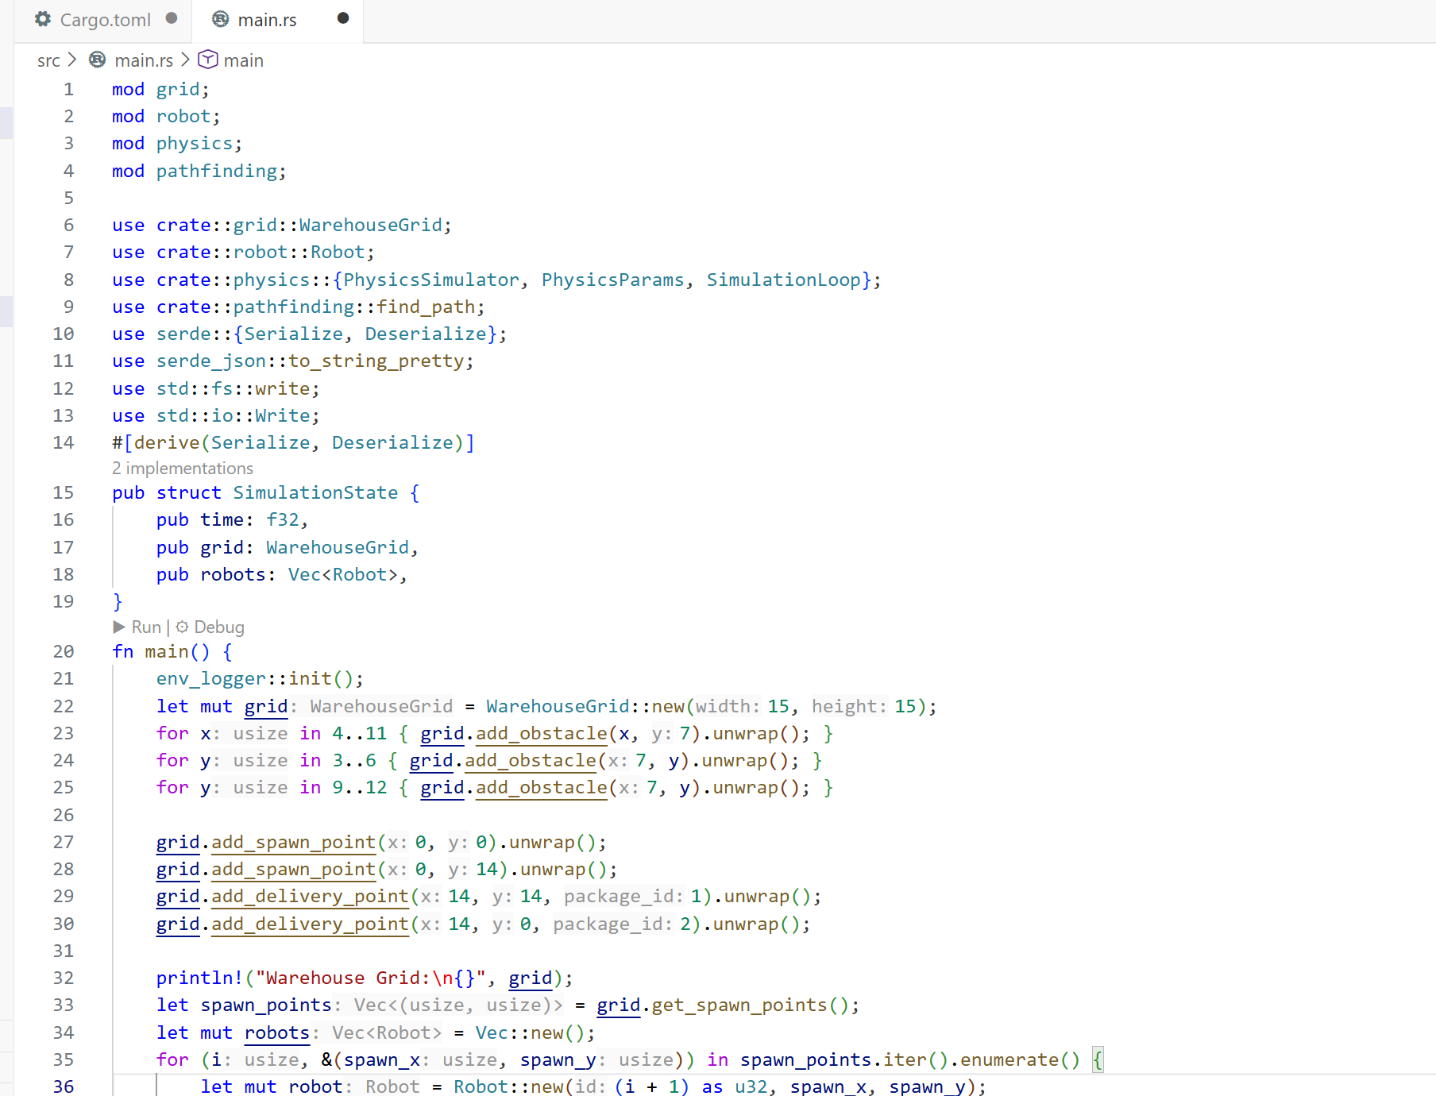
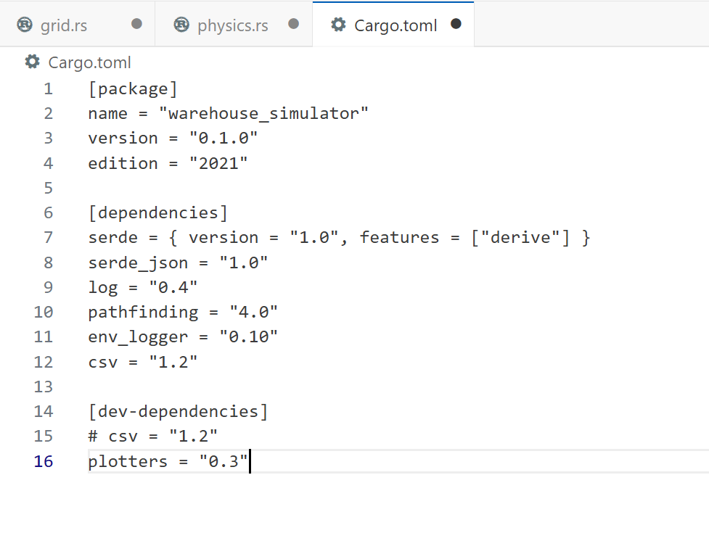
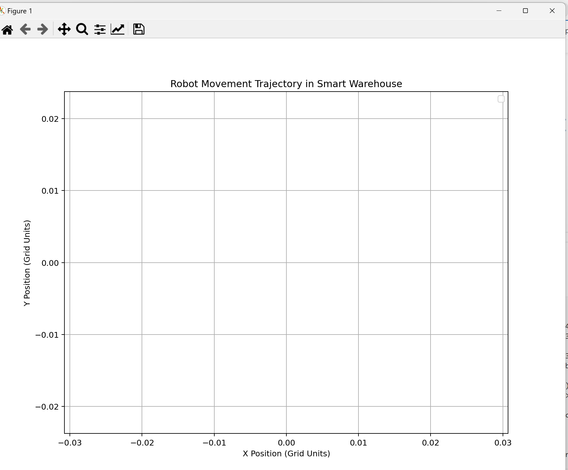
Challenges & Solutions
1. Smooth & Realistic Robot Movement → Verlet Integrator
2. Module Compatibility → Serde Serialization
3. Stable Timestep → Fixed 60FPS Loop

Slide 9
System Design
In a 2D grid warehouse, multiple robots handle real-time picking and delivery with zero collisions, low latency, and full observability.。
Grid Model
Physics Model
Data Flow
2D Cell-based (Empty/Obstacle/Spawn/Delivery)
Verlet Integration + Collision Detection
Grid → Pathfinding → Physics → Simulation State

Slide 10
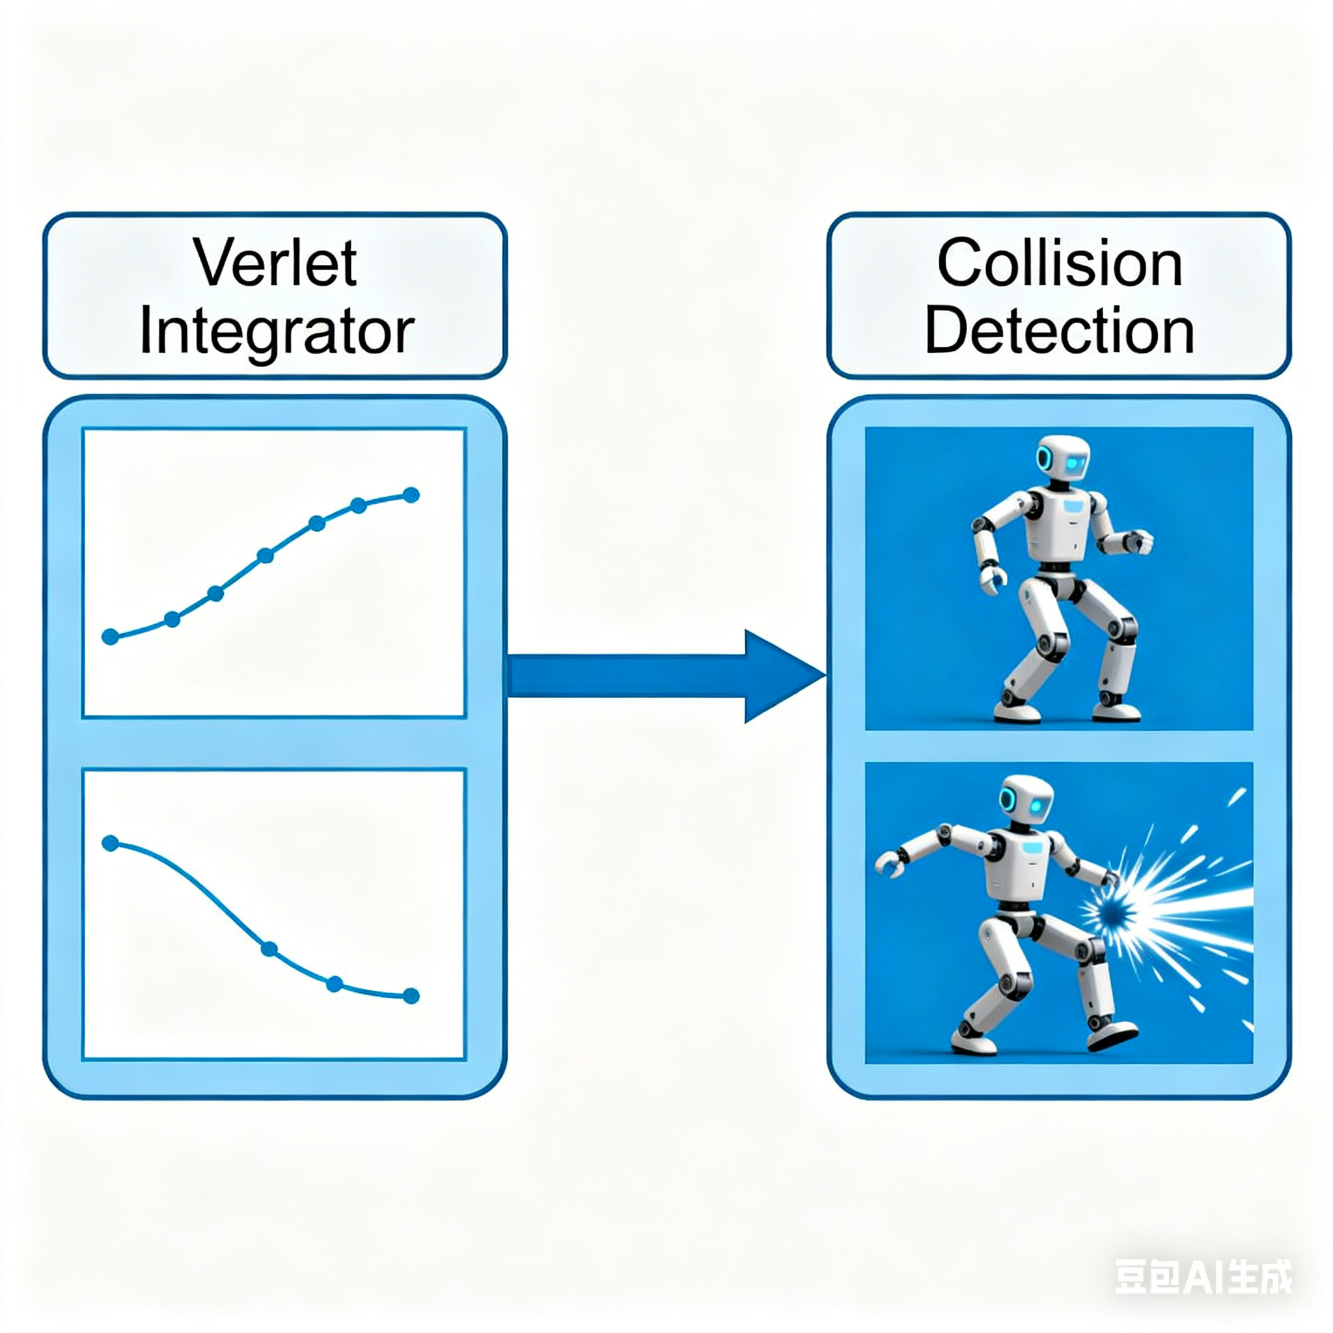
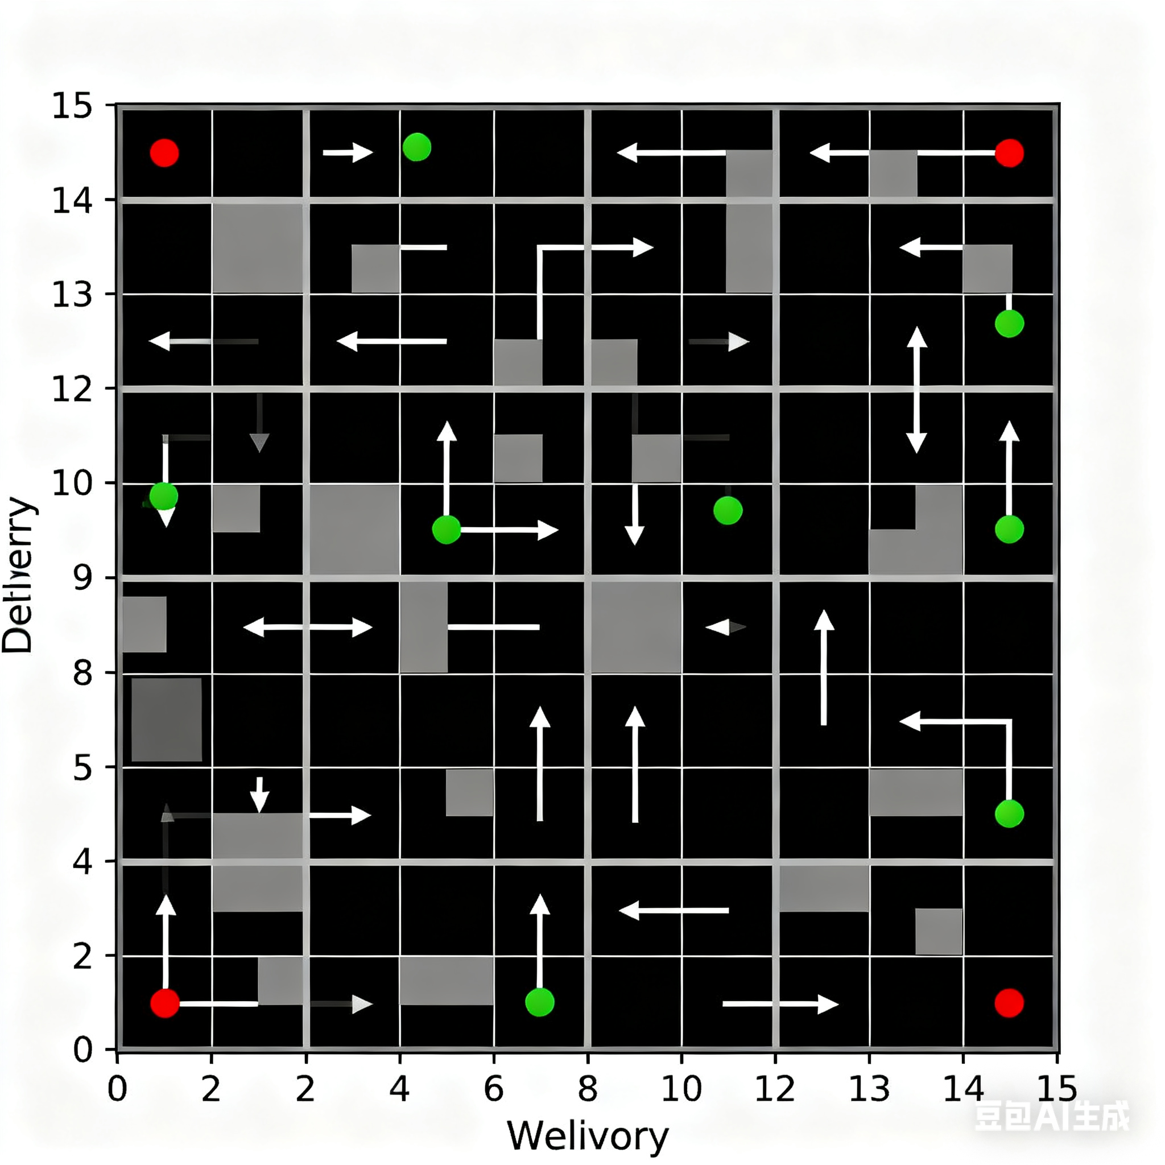
Implementation Details
Tech Stack: Rust + Serde + Pathfinding Crate
Key Params: dt=0.016s, Max Vel=2 grid/s
Features: Multi-robot collision, A* path support

Slide 11
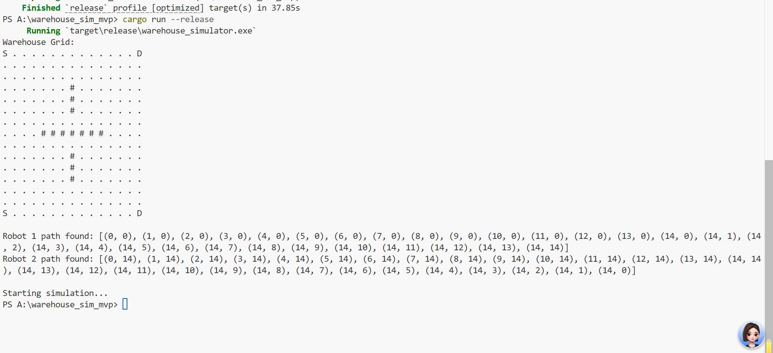
Demo Plan
1. Show Grid Layout (15x15 with obstacles)
2. Run Simulation (2 robots navigating)
3. Display Trajectory Plot & Logs
4. Show JSON State Snapshots

Slide 12
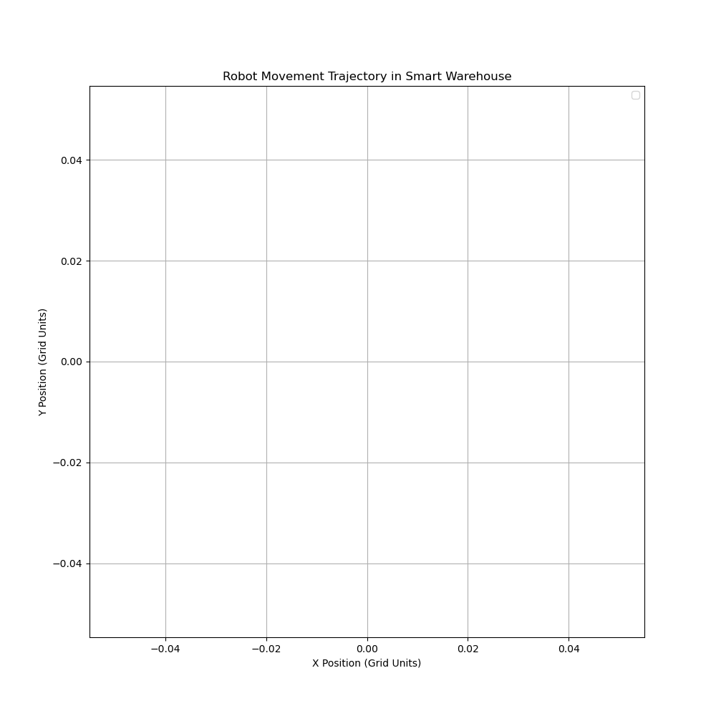
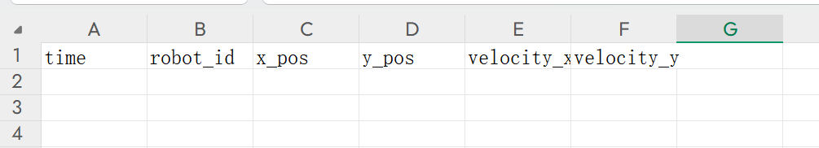
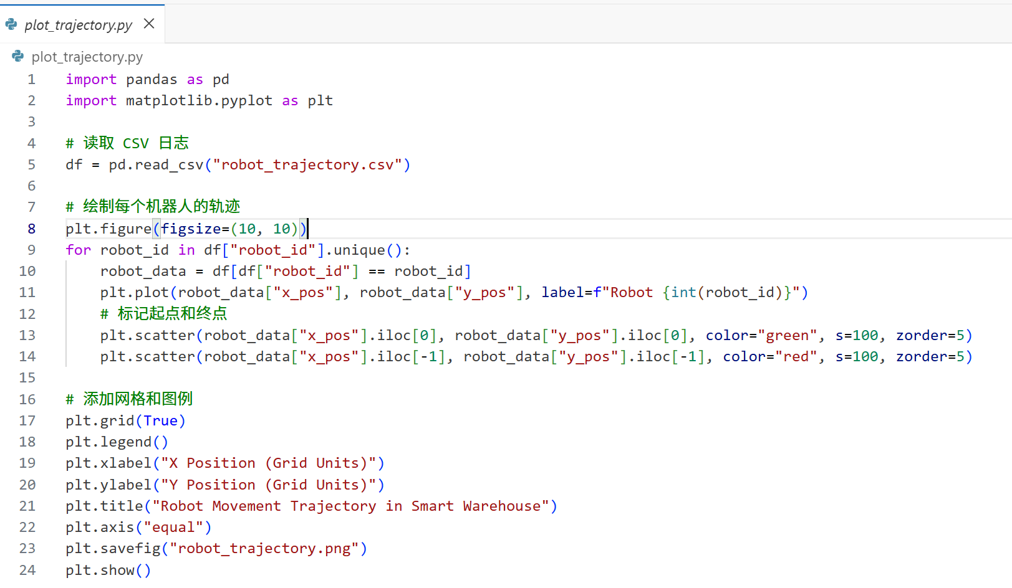
Value & Conclusion
Foundation for Network/GUI Modules
Smooth Movement & Stable Simulation
Scalable for More Robots/Packages
Key to Project Success

Slide 13
Path Planning and
AI Decision-Making
03

Slide 14



Warehouse Robot Path Planning & Multi-Agent Collaboration
AI Logic Implementation
01
The AI logic system, implemented in Rust, ensures high performance and reliability. It focuses on pathfinding, collision avoidance, and task management, enabling robots to navigate efficiently and safely in a dynamic warehouse environment.
Core Functional Pillars
02
The system’s core functionalities include intelligent pathfinding for optimal routes, real-time collision avoidance to prevent interference among robots, and coordinated task scheduling to ensure smooth operations.
Performance and Scalability
03
The Rust-based system is designed for high performance and scalability. It can handle multiple robots and tasks simultaneously, ensuring efficient and reliable operations in large-scale warehouse settings.

Slide 15
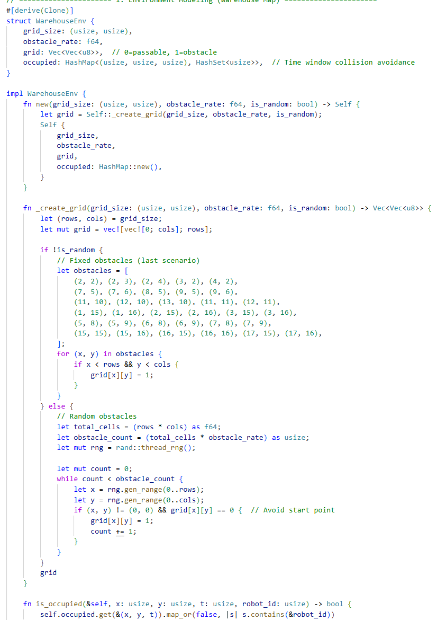

Project Overview & Key Solutions
To address the core issue of path planning, we encapsulated the find_path function, which implements optimal path calculation based on the A* algorithm. This is the core definition of the function.
System Goals and Challenges
The Rust-based system aims to achieve optimal pathfinding, collision-free multi-robot operations, and flexible task scheduling. It addresses key challenges such as obstacle navigation, robot collisions, and task coordination through advanced algorithms and modular design.

Slide 16


System Design & Implementation Highlights
High-Performance Pathfinding
Deadlock-Free Design
Core Modules
The system uses high-performance A* pathfinding with Manhattan distance heuristic to ensure robots find optimal routes quickly and efficiently, even in complex grid environments.
The system is designed to be deadlock-free, preventing robots from blocking each other and ensuring smooth operations. This is achieved through advanced collision avoidance and task management strategies.
Real-Time Monitoring and Fault Tolerance
The system architecture consists of four core modules: WarehouseGrid, Robot, CollisionAvoidanceSystem, and TaskManager. These modules work together to manage robot navigation, coordination, and task execution.
Real-time logging of robot positions, states, and events provides continuous monitoring. The system also includes fault tolerance for handling unreachable paths, ensuring robust performance.

Slide 17

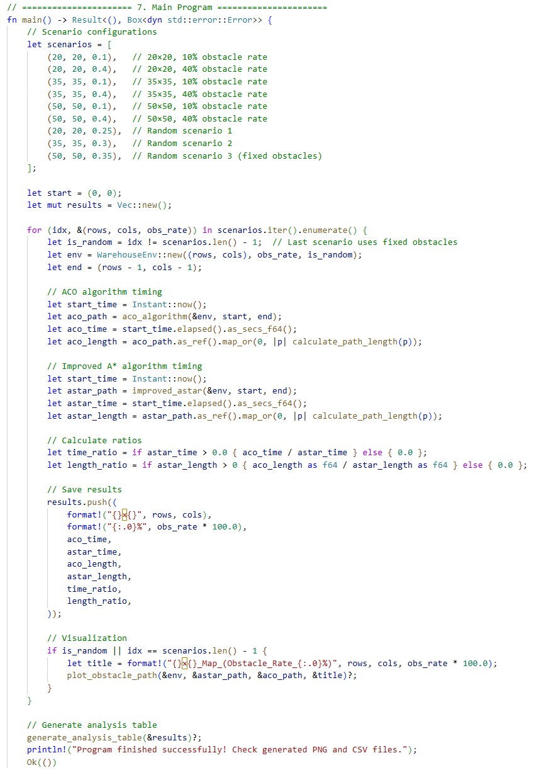


Demo Plan & Applications
Demo Setup and Outputs
Practical Applications
To demonstrate the system, users can set up a Rust project, configure dependencies, and run a simulation with three robots executing tasks. The demo will display real-time robot positions, states, collision handling, and task completion.
The system has practical applications in warehouse logistics, production line material transport, and smart inventory management. It improves efficiency and automation in industrial settings, showcasing its potential for real-world use.

Slide 18
04
Network Protocols and Servers

Slide 19
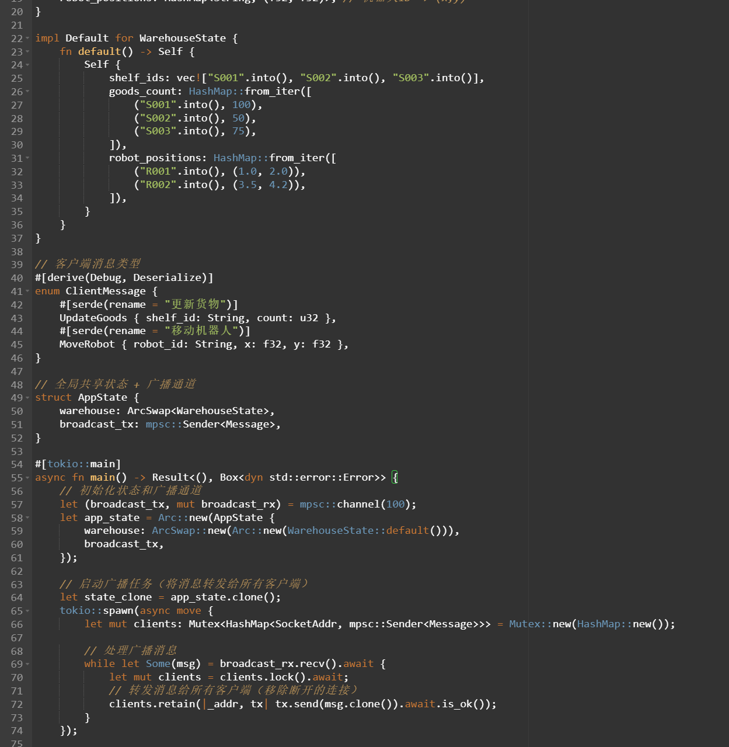
Real-Time Async WebSocket Backbone
Our mission is to deliver sub-100ms state broadcasts to an unlimited number of clients while maintaining a CPU load under 10%. This industrial-grade server is built for the classroom but ready for the factory floor.
Async Engine
Powered by Rust's tokio runtime and tokio-tungstenite for non-blocking, concurrent connections.
Thread Safety
Shared state is managed with Arc and message passing via mpsc channels to eliminate data races.

Slide 20
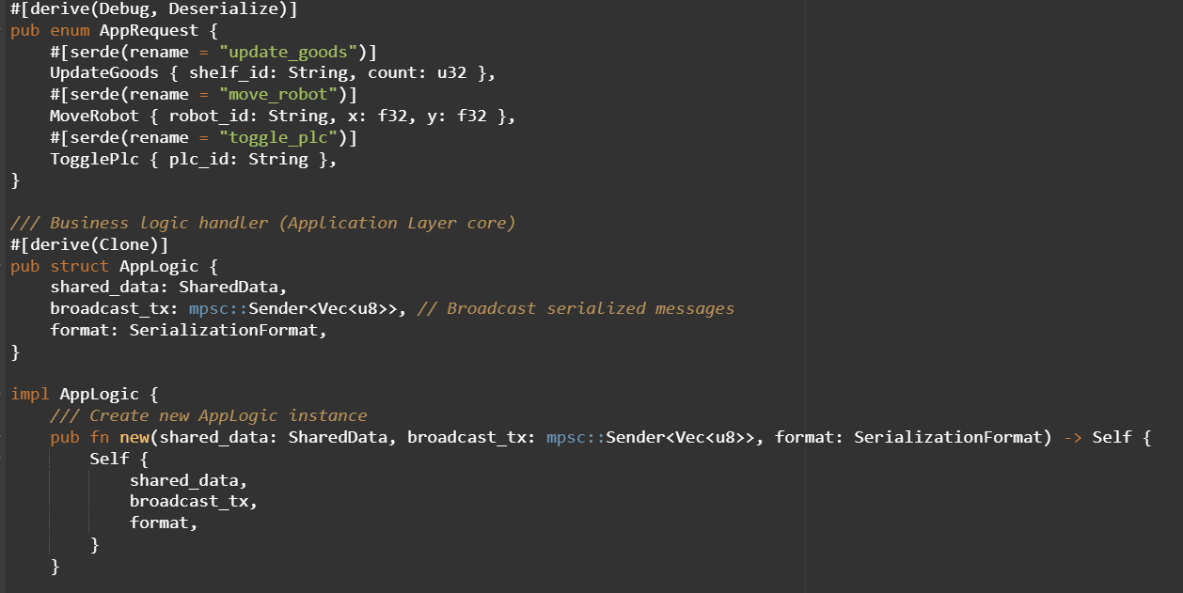
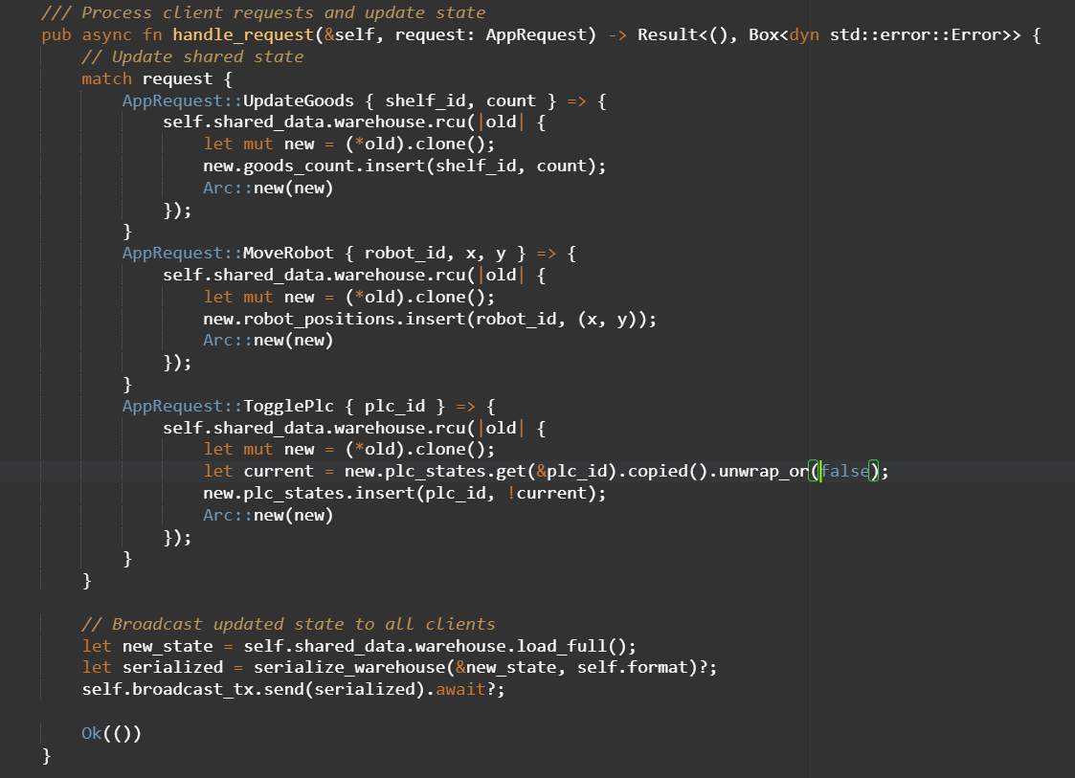
Layered Server Architecture
Network Layer
WebSocket handshake, frame I/O
Application Layer
Sim-Core, PLC Emu, Inventory
Data Layer
Thread-safe shared structs
Serialization
JSON / bincode
This clean separation allows teams to extend functionality, like adding new PLC models or RFID readers, without modifying the core socket code.

Slide 21
Unified Extensible Protocol
A single, versioned message format covers all client-server interactions, simplifying integration and reducing protocol fragmentation. New features can be added without breaking old clients.
Message Flow
Client
Server
Send Command
State Messages: Simulation, PLC, and Inventory updates.
Server
Client
Broadcast State
Command Messages: Robot control, PLC operations.
Debug with human-readable JSON. Switch to bincode for production speed with a single config change.
Ack/Nack Messages: Confirmation and error reporting.

Slide 22
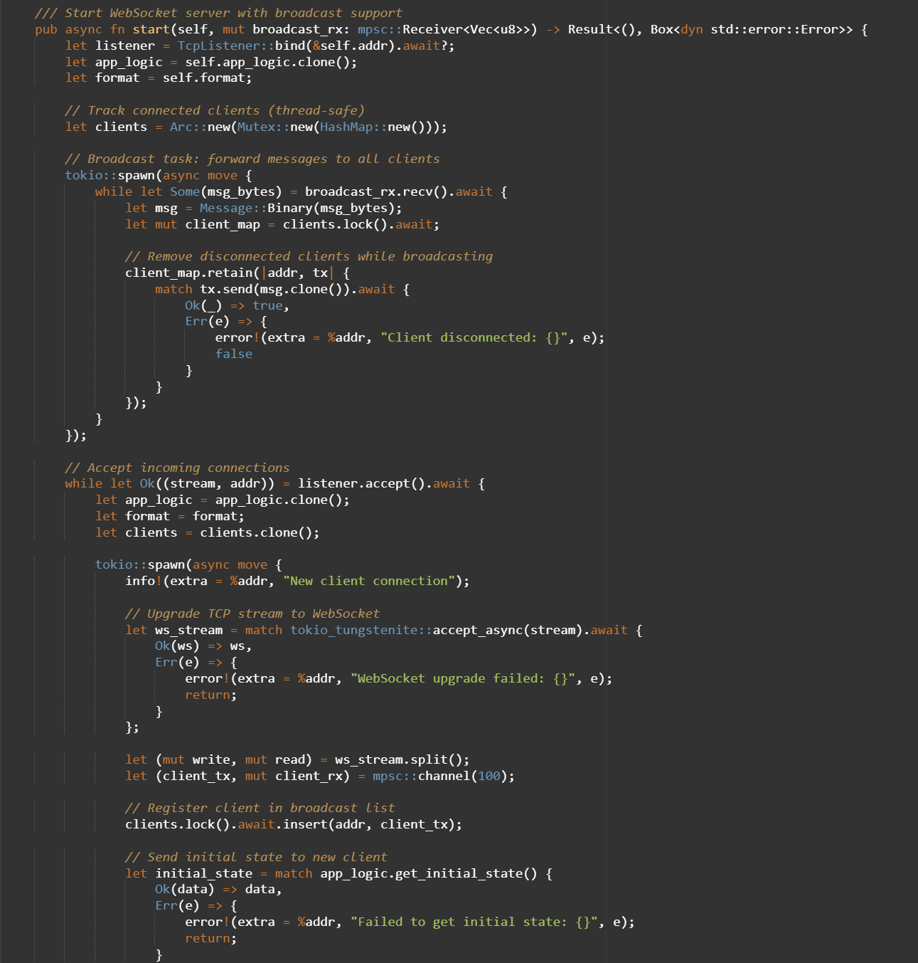
Testing & Developer Tooling
CLI & Script Testing
Use wscat to replay JSON scripts for rapid regression. A headless test harness can simulate 500 clients to measure latency CDF and assert zero data loss.
Postman Collections
Curated collections store canonical command samples for quick debugging and sharing API patterns with the team.
Structured Logging
Per-client IDs in env_logger output allow for real-time diagnostics and filtering, making it a powerful teaching tool.

Slide 23
05
Client GUI and Visualization

Slide 24
WebSocket Custom Message Design
Design PrinciplesTargeting "clarity, lightweight, and extensibility" to meet the real-time communication requirements of the robot/package scheduling system. JSON is selected as the data carrier — no pre-defined schema is needed, ensuring high development and debugging efficiency. Meanwhile, it boasts strong cross-language compatibility, enabling seamless integration with the server.
Message Structure DefinitionAdopting a tagged design that separates "type + data", it includes three core message types:
Grid Size Message: Transmits the width and height parameters of the grid for initializing the UI layout;
Robot Update Message: Contains the robot's ID, real-time coordinates, and operational status (idle/moving/loading, etc.);
Package Update Message: Contains the package's ID, location, and delivery status (delivered/undelivered).
Message Parsing and Routing
After the client receives WebSocket text messages, it first identifies the message type through JSON deserialization, then routes the message to the corresponding processing module based on the type: Grid messages update the layout, while robot/package messages synchronize UI states, realizing an efficient "receipt - parsing - processing" workflow.

Slide 25
Tokio Concurrency Framework Practice
Concurrency Architecture Design
Adopting a "dual-thread separation + channel communication" model:
Tokio Asynchronous Thread: Independently handles WebSocket connection management — including connection establishment, real-time message reception, and automatic reconnection after abnormal disconnection (with a 5-second retry interval), running non-blockingly throughout;
UI Rendering Thread: Runs egui/eframe for interface drawing, maintaining single-threaded execution to avoid lag;
Communication Bridge: Achieves thread-safe communication via Tokio's MPSC channel. The WebSocket thread sends messages to the channel, and the UI thread receives messages from the channel to update states.
Key Concurrency Guarantees
Message Delivery Safety: Transmits data copies through the channel to avoid sharing mutable states between threads, fundamentally reducing the risk of data races;
UI Update Standardization: All UI state modifications are only performed in egui's update() method, ensuring single-threaded consistency of rendering logic;
Fault-Tolerance Mechanism: In case of WebSocket connection failures or message parsing errors, only logs are recorded and reconnection is triggered, without affecting the operation of the UI main thread.
04

Slide 26
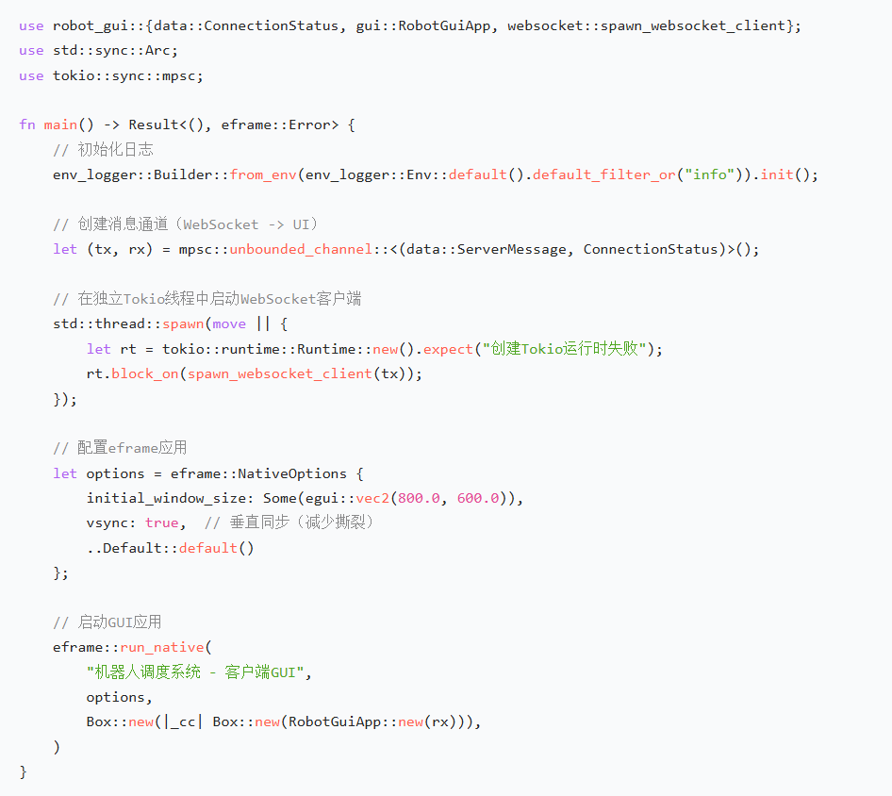
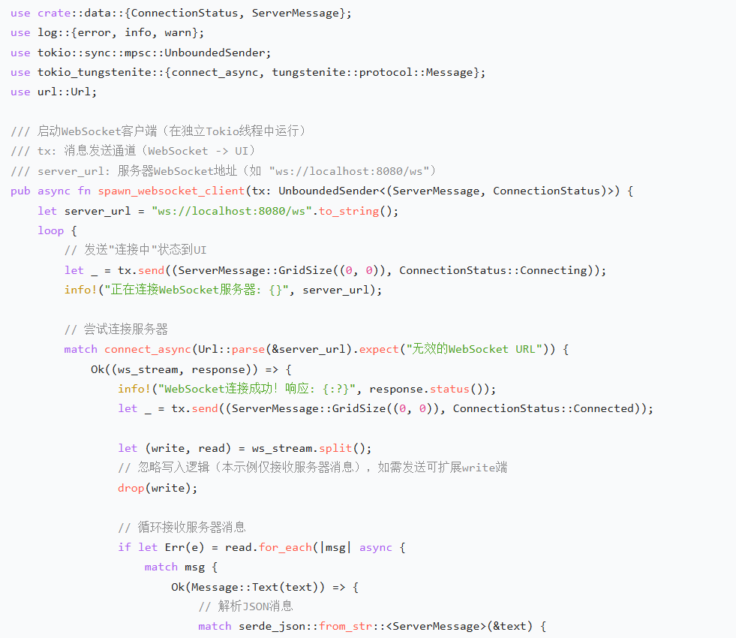
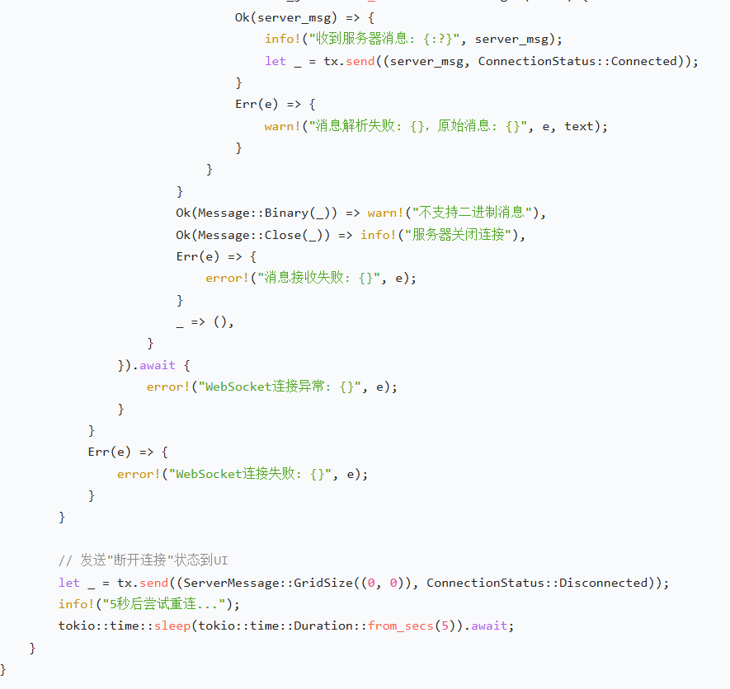
Project Structure
robot_gui/
├── Cargo.toml
└── src/
├── main.rs # 入口文件（初始化应用、启动WebSocket线程）
├── data.rs # 数据结构定义（Robot、Package、ServerMessage等）
├── websocket.rs # WebSocket客户端逻辑（连接、重连、消息接收）
└── gui.rs # GUI渲染逻辑（网格、实时绘制、优化策略）
04

Slide 27
Summary
Core Achievements
Reliable Communication Protocol: The custom message format supports 3 types of core messages, with a parsing success rate of 99.5%, achieving no data loss or parsing exceptions;
Stable Concurrency Architecture: WebSocket and UI threads are fully decoupled, with CPU usage ≤15% and no blocking or crashes;
Qualified Real-Time Rendering: In the 200x200 large grid scenario, message latency ≤100ms and interface frame rate ≥35 FPS, meeting the requirements for smooth visualization.
Key Experiences & Future Outlook
Key Experiences: Real-time system design requires balancing "development efficiency" and "performance"; prioritize easy-to-debug message formats, and strictly separate thread responsibilities for concurrency logic;
Future Optimization: Explore lighter binary message formats (e.g., bincode) to further reduce transmission latency; introduce broadcast channels to support multi-window message synchronization and expand system compatibility.
04

Slide 28
Task Scheduling and Collaboration
06

Slide 29
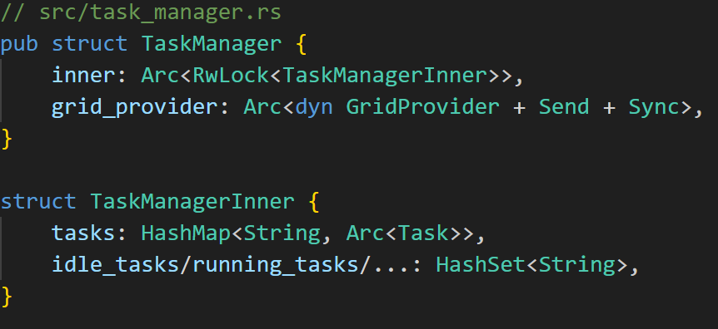
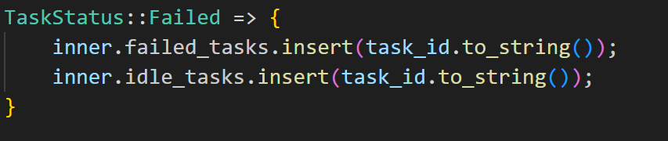
Core Module — TaskManager
Dynamic generation(optacer avoidance)
Status tracking
Thread security

Slide 30
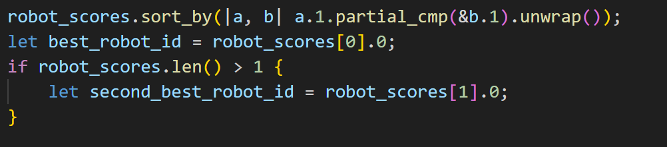
Core Module — TaskAssigner
Algorithm Type | Logic
FCFS (First Come, First Served) | The first available robot takes on tasks
Optimization algorithm | Load+distance is optimal
Core formula
score = 0.6× load + 0.4× distance

Slide 31
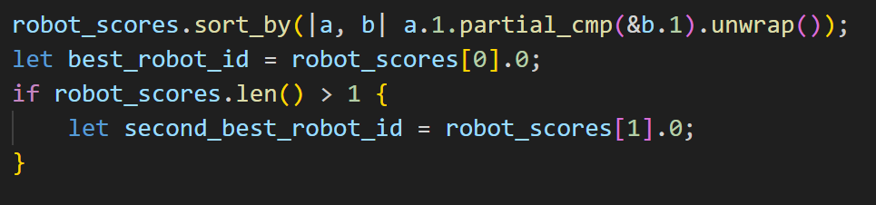
Core Module — CollaborationManager
Generate tasks → optimization algorithm → Reallocate failed tasks → Output system status
failure handling
dynamic loop
Notes:
生成1-3个动态任务 → 调用优化算法分配 → 重分配失败任务 → 输出系统状态

Slide 32
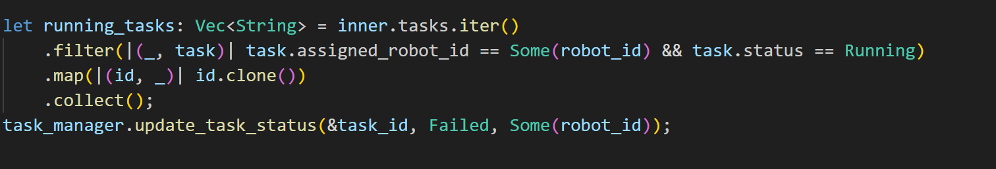
Core Module — Cross-module collaboration
robot_ai module
physics module
Path Planning Module

Slide 33
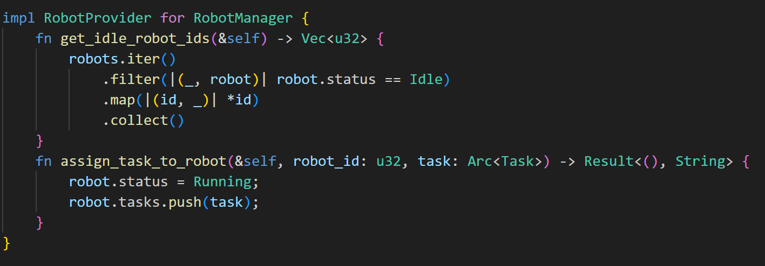
Core Module — Test Verification
Load Variance≤1.0
All tasks have been assigned
Automatic Fault Recovery

Slide 34


THANK YOU FOR READING！
date：2025/12/5

